Slide 1
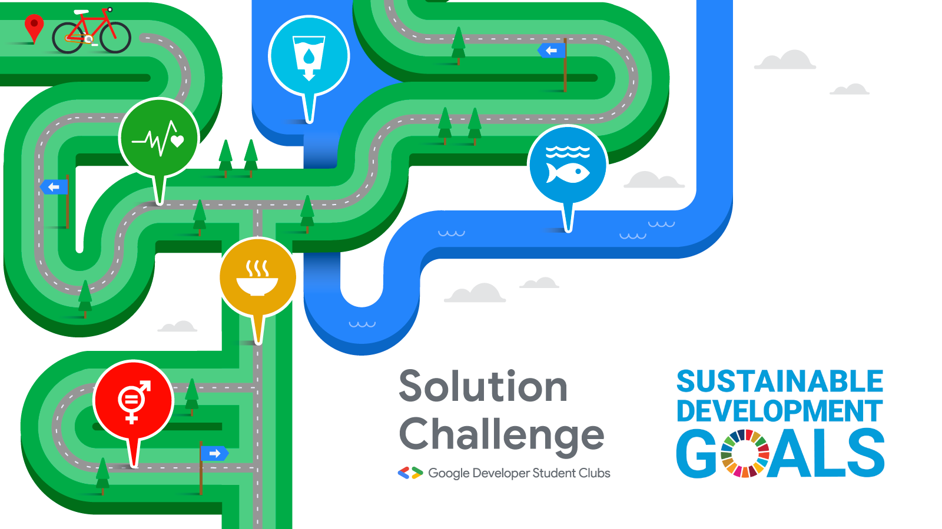

Slide 2
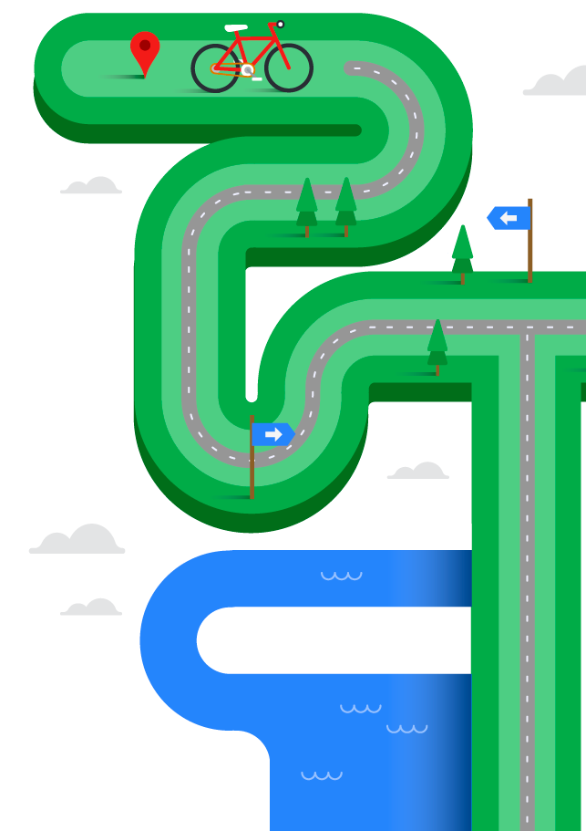

Problem Identification
Getting started on your project by asking the right questions and evaluating your opportunities.

Slide 3
Get Our Slides
https://github.com/leilanihagen/solution-challenge-ID-workshop

Slide 4

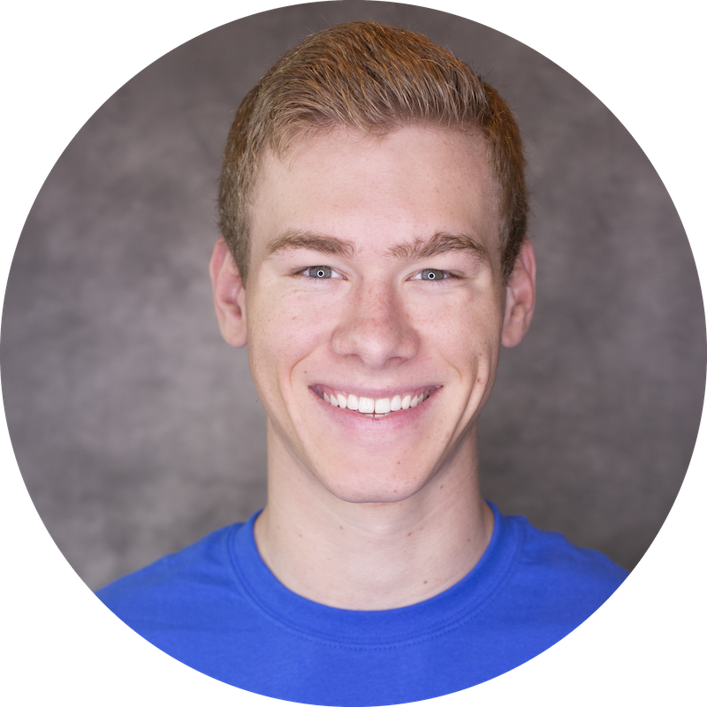

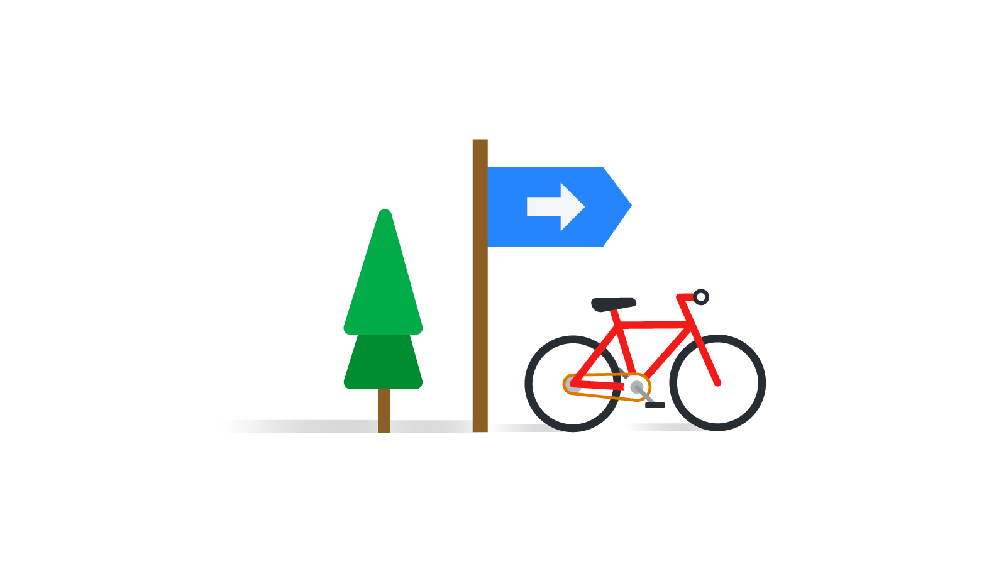
Speakers
Introductions!
Evelyn Le DSC Lead
University of Texas - Dallas
Alex Robinson DSC Lead
University of Central Florida
Erin Tan DSC Lead
Mt. San Antonio College

Slide 5
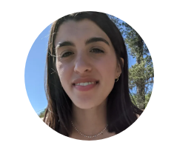
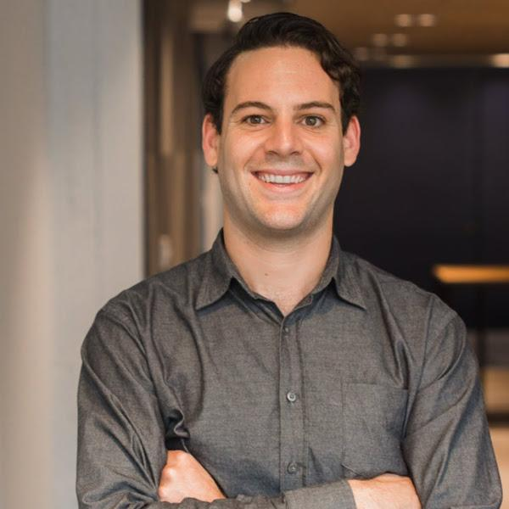
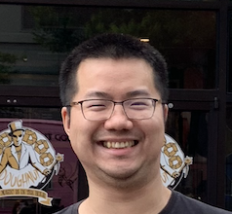
Speakers
Introductions!
Li-Yun Wang
DSC Lead
Portland State University
Leilani Hagen
DSC Vice President
Portland State University
Daniel Fiorillo
DSC Community Manager
Google

Slide 6
Today’s Goals
What should you walk out of this workshop with
Understand Solution Challenge 2021’s focus and judging criteria
Define and limit the scope of your problem
Identify potential market and users

Slide 7
Agenda
CST Timezone
1:05 pm: Focus & Judging Criteria
1:20 pm: Identify the Right Problem
1:35 pm: Group Activity 1
1:50 pm: Break
1:55 pm: Understand Market and Users
2:10 pm: Group Activity 2
2:30 pm: Q&A

Slide 8
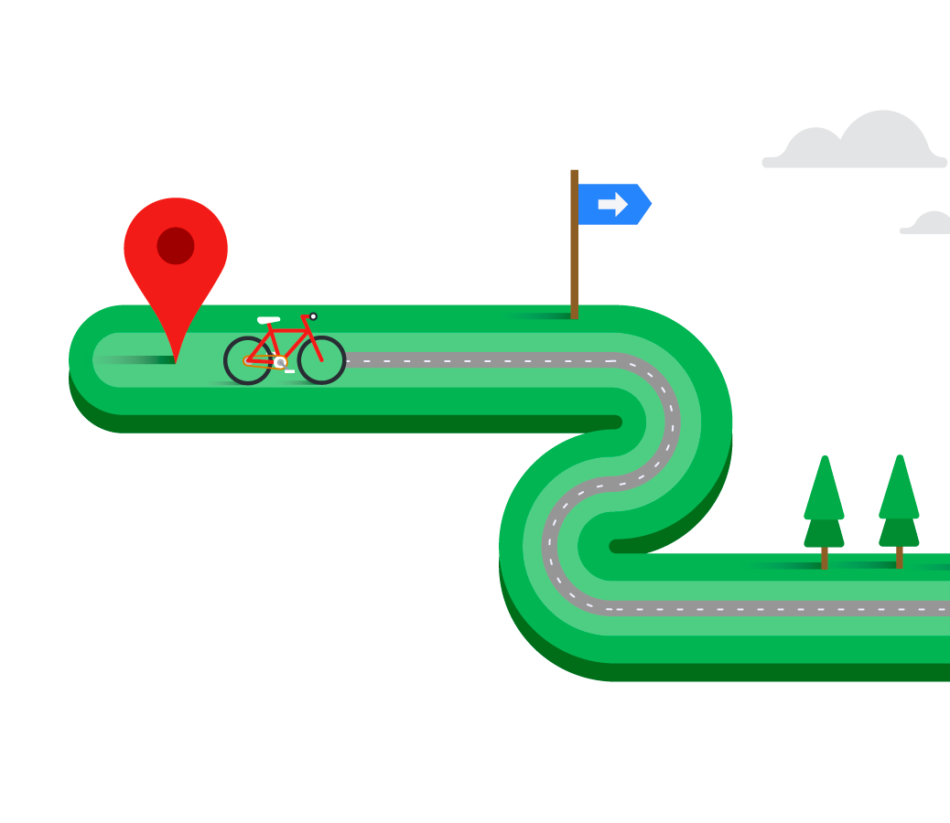
Focus & Judging Criteria

Slide 9
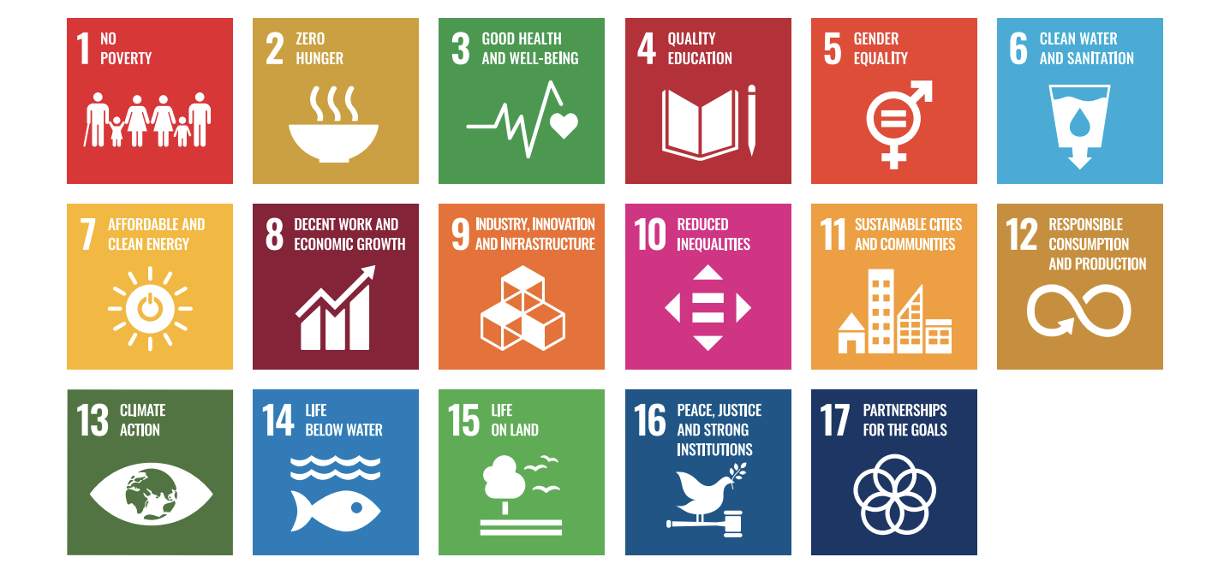
The Google Developer Student Clubs 2021 Solution Challenge mission is to solve for one of the United Nations’ 17 Sustainable Development Goals using Google technology.
Created by the United Nations in 2015 to be achieved by 2030, the 17 Sustainable Development Goals (SDGs) agreed upon by all 193 United Nations Member States aim to end poverty, ensure prosperity, and protect the planet.
Notes:
@Danny

Slide 10
Judging criteria
A panel of Google judges will evaluate your project using this scoring system:
IMPACT - 60 POINTS Does the entry establish a clear challenge focused on one or more of the United Nations 17 Sustainable Development Goals? Is it explained in a clear manner with specific Sustainable Development Goal targets they are looking to solve for? [10] How effectively does the solution address the challenge identified by the team? [20] Is there evidence of a next step? Does the team display a plan for future extension if they were to continue? [10] Is there evidence that the solution has been thoroughly tested with real users? [10] Is there evidence that the solution was iterated upon based on user feedback? [10] | TECHNOLOGY - 40 POINTS Does the solution implement all the technical components needed to solve the challenge? [10] Has the team clearly explained what Google technology they used, why and included guidance on how to run their code? [10] Does the video demonstration show the working solution and how a user will interact with the solution? Does the demonstration highlight how the Google technologies are implemented and also mention the value the technology provides the users? [10] Has the team made effective product and technical decisions for their solution? [10]
Notes:
@Danny

Slide 11
FAQs
Q: Can my solution solve a problem outside of the scope of the 17 Sustainable Developer Goals?
A: For Solution Challenge 2021, we require your submitted solution to solve for at least one or more of the 17 SDGs. When you have submitted your solution, please review all the 17 SDGs to understand which SDG your solution is focused on and what SDG targets you are looking to solve for.
Notes:
@Danny

Slide 12
FAQs
Q: Given the implications of social distancing, our ability to test with users was impacted -- will the judges consider this?
A: Our judges will surely be mindful of the limitations that have been added by COVID-19. This includes but is not limited to:
Ability to meet as a team
Ability to have users test the solution
Lack of internet access or proper developer environments due to displacement from your college campus.
Notes:
@Danny

Slide 13
FAQs
To read the full list of frequently asked questions head over to the FAQ page at goo.gle/solutionchallenge.
If you have a question that is not answered below, please reach out to your DSC Lead or visit Parthean.
Notes:
@Danny

Slide 14
Identify the Right Problem
Notes:
Since you’ll be building a solution for this competition, you obviously need a problem first. Thinking of a problem straight off the bat can be hard, so here we’ll show you how to divide between a good and bad example, and the thinking process for it.

Slide 15


Good & Bad Examples (Using 1 UN Goals)
Bad examples:
Broad ideas
Ex: Neuroscience application
Unrelated ideas
Ex: Google Maps for the moon
Ideas that push time constraints
Ex: Automotive accident detection system
We only have 2 months!
Notes:
Ex: Neuroscience application: you have a theme, but what specifically are you going to apply your project to in terms of neuroscience? Brain development? Cognitive science? Make your project idea as specific as possible to be able to branch off of your idea easier without it going too off topic.
Ex: Google maps for the moon: It sounds really cool and is a really cool project idea, but in what way is it related to the UN Goals or how does it apply to community improvement? It’s also really difficult to do unless you have access to moon data, which leads us to our next point…
Ex: Automotive accident detection system: This idea is actually not a bad idea, considering a lot of organizations and companies are looking towards doing this and would apply to the well-being and infrastructures UN Goal. However, we’d imagine this would take a long time consider the amount of data you have to test it against in real roads. Remember, we only have 2 months!
Next Slide

Slide 16


Good & Bad Examples (Using 1 UN Goals)
Good examples:
Be as specific as possible
Ex: Book recommendation system based off of preferences (#4)
There’s room for growth
No need for it to be scalable right away
Plan for improvements and testing
Ex: Carbon footstep calculator - apply it to a multitude of things
Be ambitious, but realistic
Are there people you can reach out to for help?
Notes:
Ex: Book recommendation: this is pretty specific, as it’s not just a “book app”, and narrows it down to what the user actually prefers or wants. You can easily branch off of this idea with due time, and it even applies to goal #4, quality education.
There’s no need for it to be scalable right away - if you can’t think about how your project can grow, that’s completely fine. But you want to plan for improvements with your project to enable it to grow.
Ex: Carbon footstep calculator - you can grow this app like crazy, you can put it on the web, put it on devices, put it on your daily lives, etc. There’s definitely room for growth with this one.
It’s pretty difficult to do a project without help, and so that’s why we’re here! As leads, we want you to take your project to the next level, and so we’ll work to provide a network that you can use for help in developing your project. However, this help must be feasible. For example, you can’t ask us to try to get Sundar Pichai to mentor you due to a very ambitious project, but we’ll try our best to connect you with great mentors.
Next Slide

Slide 17
How to start thinking about your problem
It doesn’t have to be huge!
Choose a theme
Can be related, but not limited to:
Current events
Local problems
Last step(s)
Choose a UN Goal it could apply to
Network with those involved in dealing with the problem
Apply the rubric to your idea
Notes:
Your project should be working towards supporting a UN goal, but doesn’t have to solve it completely. We’re not asking you to cure cancer here. Instead, try and look towards your local communities - what do people complain about the most? What do you notice that needs change within your network? Maybe you can build a project and then relate it to a UN goal.
As such, make sure to network with those involved in your problem. For example, is your project related to parks development for good health and well-being (#3)? Maybe you can reach out to the city council to learn more about the problem and see if your project can apply to helping out with it.
Last but not least, as you’re developing your project, you want to make sure you can apply the judging criteria closely to it. You want to get as many points as you can from the judges, and they’ve given you almost the full guidelines as to what they’re looking for in your project.
Next slide

Slide 18
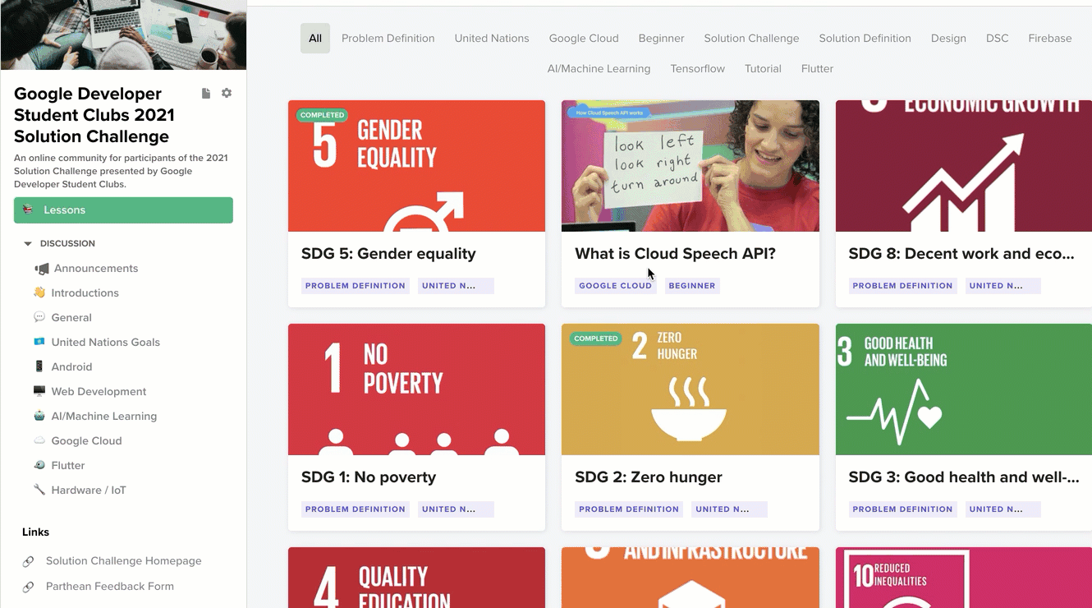
Notes:
If you want more information about the target of each UN Goal, as well as background on UNICEF’s effort to build upon the goals the UN has made, utilize the Parthean platform to research more about your project! Start with this one to research more into what the UN specifically has in mind. Pass off to Leilani.

Slide 19
Generating project ideas from your interests!

Slide 20
Defining a problem and narrowing down scope
Steps
1. Write down the problem… what exactly is causing it?
2. Write down some “Things that could help” ways in which you can help solve the problem.
3. Do research, reflect on your ideas, modify and eliminate some based on your research, then select 1-2 of your ideas to tackle.
Notes:
First step is identifying a general problem you want to solve within your interests. Write down the problem, what exactly is causing it? “I know what the problem is Leila.. Oceans are full of garbage” (but because ppl don’t have an organized way to clean them up)
Write things that could help. Now that you’ve identified the root of the problem. Creative part, anything goes. Brainstorm.
Do research on your topic, what solutions does it need, what have people already created?. Reflect on the ways you can help solve the problem, which may be most impactful, and ultimately select a 1-2 action items or goals for how you can contribute to the problem. Some project may be able to handle more actions items, others not.
After doing some research, you may have to do another iteration of writing down ways that could help, or modify some of your initial ideas. We will walk through an example on the next slide.

Slide 21
Define + Narrow Scope Example: Disinformation
Step 1 - Write down the problem:
Many people struggle to distinguish true from false information that they read and watch on the internet, leading to misinformed people.
Search for the root of the problem: Look for action words and verbs in your problem statement such as struggle and distinguish.

Slide 22
Define + Narrow Scope Example: Disinformation
Step 2 - Write down things that could help:
Root of the problem: struggle to distinguish false information sources
An online community to flag disinformation sources and learn about disinformation
A Facebook plugin that helps people recognize disinformation posts
A web browser plugin that helps people recognize disinformation on the internet
Notes:
Identifying the root of the problem should help you generate possible things that could help to address the root of the problem
Write down whatever comes to mind for project ideas. Make a list.Think of the different places the problem occurs, the different communities or sub-communities it affects.

Slide 23
Define + Narrow Scope Example: Disinformation
Step 3 - Do research, modify and eliminate, pick an idea:
Research: discussion communities for online content and good web browser plugin tools on this topic already exist
An online community to flag disinformation sources and learn about disinformation
A Facebook plugin that helps people recognize disinformation posts
A web browser plugin that helps people recognize disinformation in articles and other text sources
Notes:
Once you do some initial research on existing products and on your problem area, you can come back to the drawing board of your project ideas list.
Online community already exists
After I did a bit of initial research on this idea, I found that there are lots of Twitter plugins and bots to help track down propaganda and bot accounts, but it seems like there may be less for Facebook, so I kept my original idea of a Facebook plugin intact without modifications
Also, I found a browser plugin that helps people determine if videos they are watching are accurate/true, but the service has yet to expand to text sources yet, so I modified my idea here to be specific to a plugin for determining text source credibility instead of internet content in general

Slide 24
Engage with your community!
Notes:
If the past discussion about identifying a problem and narrowing scope was daunting to you, maybe you just need to take a step back and:
Engage with your community to see what kinds of problems they are facing

Slide 25
Talk to Someone in Your Community
Who should you ask?
Professors,
Local businesses,
Non-profit orgs,
Even Friends & Family!
Where do you spend most of your time at work (this can be virtual)?
What do you find most difficult in your job?
What tools do you wish you had available?
Notes:
Once you do some initial research on existing products and on your problem area, you can come back to the drawing board of your project ideas list.
Online community already exists
After I did a bit of initial research on this idea, I found that there are lots of Twitter plugins and bots to help track down propaganda and bot accounts, but it seems like there may be less for Facebook, so I kept my original idea of a Facebook plugin intact without modifications
Also, I found a browser plugin that helps people determine if videos they are watching are accurate/true, but the service has yet to expand to text sources yet, so I modified my idea here to be specific to a plugin for determining text source credibility instead of internet content in general

Slide 26
Team size
Remember: teams may have up to 4 members!
We recommend having 4 members on your team :)

Slide 27
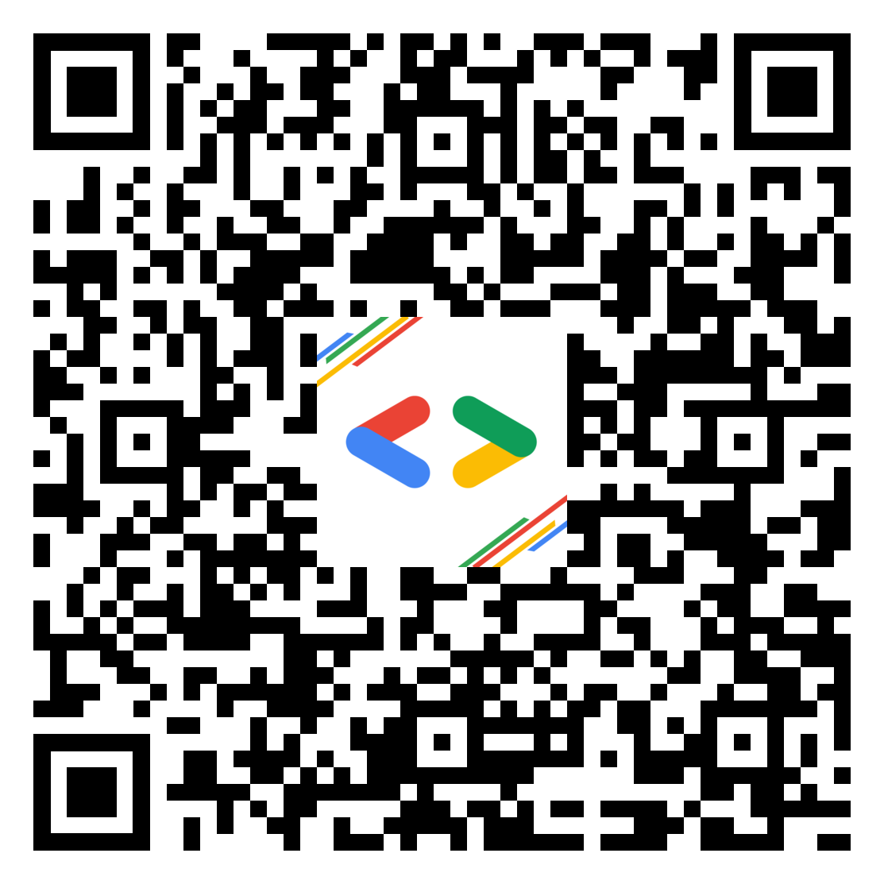
Group Activity #1:
Idea Generation
Create a list of 3-5 project ideas
Access using this link or QR code: http://bit.ly/pi-group-activity
Find the folder corresponding to your team break-out group number

Slide 28
Group Activity #1:
Idea Generation
Create a list of 3-5 project ideas
This is the creativity phase, anything goes!
Imagine the problems different people in your community are facing...

Slide 29
Potential Market and User
Notes:
Welcome back to the second half of our workshop today. We hope that you had some fun with your first activity.
So it’s just a quick reminder that when it comes to generate ideas don’t limit yourself. Great ideas don’t usually come when you start your train thought with “Oh, I know how to build an app using Technology X, so I will come up with an idea using it.” In contrast, you will be more often have some ideas or problem you are interested in first, like what Erin and Leilani pointed out at the beginning, then you pick up necessary skills along the way.
Same logic goes for the Solution Challenge, or like what you did in your first activity. We want you to spend your energy on looking into a problem that you care about and you love to work on, and it’s our part to help you learn new skills or provide certain resources to support your project. Then, after you have some problems you may want to tackle, how do you know which one would has the most opportunities for you to deliver an impactful solution? That’s in when we need to start wearing your business hat and think about factors like Market and User.

Slide 30
Understanding Markets
Some markets are better than others
Size - The impact & scale of your problem/market
Acquisition - How easy or costly does it take to acquire new customer?
Growth - Is the market growing? How’s its future going to look like?
Notes:
So not all market are the same.
Ex:
So how do you know which market is better another? Some factors you may want to consider would be.

Slide 31
Judging criteria
A panel of Google judges will evaluate your project using this scoring system:
IMPACT - 60 POINTS Does the entry establish a clear challenge focused on one or more of the United Nations 17 Sustainable Development Goals? Is it explained in a clear manner with specific Sustainable Development Goal targets they are looking to solve for? [10] How effectively does the solution address the challenge identified by the team? [20] Is there evidence of a next step? Does the team display a plan for future extension if they were to continue? [10] Is there evidence that the solution has been thoroughly tested with real users? [10] Is there evidence that the solution was iterated upon based on user feedback? [10] | TECHNOLOGY - 40 POINTS Does the solution implement all the technical components needed to solve the challenge? [10] Has the team clearly explained what Google technology they used, why and included guidance on how to run their code? [10] Does the video demonstration show the working solution and how a user will interact with the solution? Does the demonstration highlight how the Google technologies are implemented and also mention the value the technology provides the users? [10] Has the team made effective product and technical decisions for their solution? [10]
Notes:
Part of creating an effective solution for the solution challenge is the ability to solve problems using solutions that could potentially continue after submission deadline. The way to do this is to consider some of the main points on the previous slide. Understand your market, potential friction for users, and the growth/scalability of your solution.

Slide 32
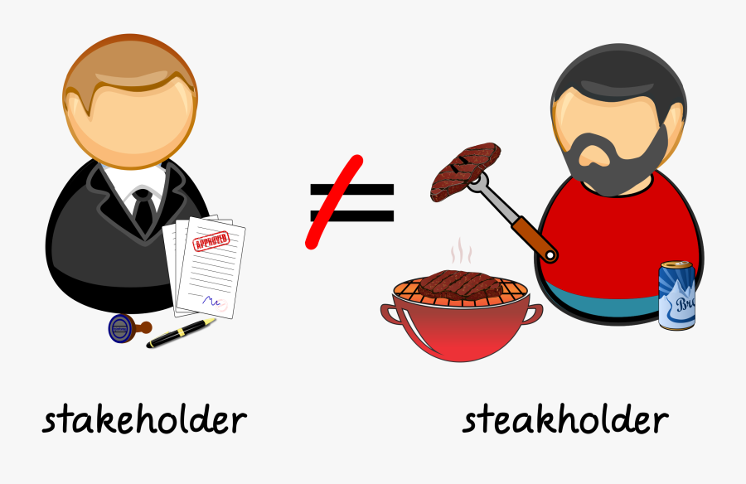
Know Your Stakeholders

Slide 33
Know Your Stakeholders
Who are affected by the problem that you are trying to solve
Customers/ Users
Competitors
Suppliers/ Partners
Notes:
When it comes to people factor in your problem, you users wont be the only group you need to consider about. You will also want to understand who will be your competitors, or in other words, who are trying to solve the same problem with you. Only by understanding how and why the available solutions are not effective could you offer a better one.
Also, others who may benefits the problem you are trying to solve are also a great clue for you on how to develop your solution.

Slide 34
Market Research
The quickest way to learn about your market is to do some online research
General Knowledge & Facts
Available Solutions/Products
News & Trends

Slide 35

How to start your research

Slide 36
Notes:
Evelyn:
Also, make sure you utilize the Parthean platform to get more information about the target of each UN Goal as well as UNICEF’s effort on the goal you want to tackle!

Slide 37
Who are your users
Think about their
Characteristics - Demographics, Age, Occupations, etc
Motivations & Goals - What they want to achieve
Frustration - What is blocking them that your solution could help
Notes:
During your market research, also try to figure out who your users might be.
Think about their characteristics like demographics, age group, jobs, etc, as a starting point, but don’t let it distract you from more important factors are their Goals and their Frustrations.
When you try to solve a problem for them, think about what they were trying to achieve, and what are blocking them from reaching those goals, so that your solution can meet their needs.

Slide 38
Validate your assumptions
During your market and user research, remember to:
Document your assumption
Revisit during your design phase
Test it out later!

Slide 39
Judging criteria
A panel of Google judges will evaluate your project using this scoring system:
IMPACT - 60 POINTS Does the entry establish a clear challenge focused on one or more of the United Nations 17 Sustainable Development Goals? Is it explained in a clear manner with specific Sustainable Development Goal targets they are looking to solve for? [10] How effectively does the solution address the challenge identified by the team? [20] Is there evidence of a next step? Does the team display a plan for future extension if they were to continue? [10] Is there evidence that the solution has been thoroughly tested with real users? [10] Is there evidence that the solution was iterated upon based on user feedback? [10] | TECHNOLOGY - 40 POINTS Does the solution implement all the technical components needed to solve the challenge? [10] Has the team clearly explained what Google technology they used, why and included guidance on how to run their code? [10] Does the video demonstration show the working solution and how a user will interact with the solution? Does the demonstration highlight how the Google technologies are implemented and also mention the value the technology provides the users? [10] Has the team made effective product and technical decisions for their solution? [10]

Slide 40
Group Activity #2:
Idea Selection
Evaluate previous ideas and pick the best one(s)
Access using this link or QR code: http://bit.ly/pi-group-activity
Find the folder corresponding to your team break-out group number

Slide 41
Small Team Building! - Tip #2
Our recommendations:
Elect a leader
Maybe…
Rotate leader role
Definitely:
Make decisions together!
Notes:
Leader should help coordinate the whole group, help make collaboration easier between different part of the project.
You can elect a group leader during the team exercises for practice

Slide 42
Group Activity #2:
Research + Project Selection
Evaluate previous ideas and pick the best one
TAKE NOTES:
Do some quick market research: What similar products exist?
Identify target users: Who do I expect to use my product/app/service the most? How old are they? What do they do?
Finally, choose 1 of your ideas from activity #1 based on research, and how to best serve your target users.

Slide 43
More Resources!

Slide 44

Notes:
Alex: for those of you who are participating in the solution challenge and want to learn how to use a bunch of new technologies and platforms to build web apps, DSC UCF is kicking off our Building a Full Stack Web App Series tomorrow at 2:00pm eastern time. Our first session is Front-End Design using HTML, CSS, and Bootstrap. Next week we’ll be doing JS and React.
The event is open to students and the general public from all skill levels and backgrounds. Doesn’t matter if you’re a new developer or an experienced one. We’ll teach you everything you’ll need to create a web app of your own from A-Z over the next six weeks through weekly sessions.
If you’re interested, check out our event page at the links below. I’ll go ahead and drop them in the chat for those who are interested in attending!

Slide 45
Participate in our Community Engagement Challenge! Chance to win a Google DSC Backpack!
The challenge:
Discuss the Solution Challenge with your DSC community
Find someone in your community to interview about the Solution Challenge
More details in the Challenge Form!

Slide 46

Participate in our Community Engagement Challenge!
https://rb.gy/2xwwrg

Slide 47
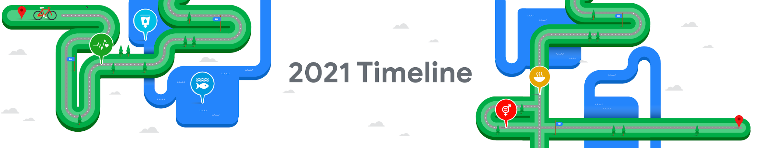
Step 1: Join a Google Developer Student Club
Step 2: Register for the 2021 Solution Challenge by submitting this form
Step 3: Form a team
Step 4: Select a United Nations Sustainable Development Goal
Step 5: Identify a Solution
Step 6: Learn & build
Design the front-end interface
Design the back-end technology
Step 7: Test your solution
Step 8: Iterate code
Step 9: Record a demo video and submit by March 31st
Step 10: Top 50 solutions announced (May)
Step 11: Top 50 deep mentoring (May-June)
Step 12: Top 10 finalists announced (July)
Step 13: Top 3 winners announced live on YouTube (August)
Step 14: Celebrate all the 2021 Solution Challenge participants!
Notes:
Remind participants of the timeline and encourage new students to join the competition with their DSC leads

Slide 48
We can’t wait to see what your team builds!

